Slide 1
Lexical Semantics
Pawan Goyal
CSE, IIT Kharagpur
Week 8, Lecture 1
Lexical Semantics
Week 8, Lecture 1

Slide 2
Lexical Semantics
Definition
Lexical semantics is concerned with the systematic meaning related connections among lexical items, and the internal meaning-related structure of individual lexical items.
To identify the semantics of lexical items, we need to focus on the notion of
lexeme, an individual entry in the lexicon.
What is a lexeme?
Lexeme should be thought of as a pairing of a particular orthographic and phonological form with some sort of symbolic meaning representation.
Orthographic form, and phonological form refer to the appropriate form part of a lexeme
Sense refers to a lexeme’s meaning counterpart.
Lexical Semantics
Week 8, Lecture 1
2 / 18

Slide 3
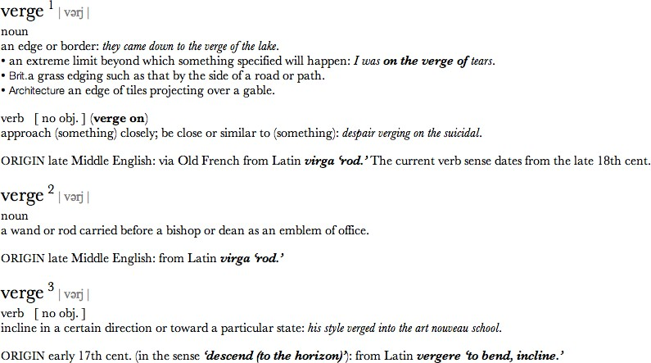
Example
Lexical Semantics
Week 8, Lecture 1

Slide 4
Example: meaning related facts?
Definitions from the American Heritage Dictionary (Morris, 1985)
right adj. located near the right hand esp. being on the right when facing the same direction as the observer
left adj. located near to this side of the body than the right
red n. the color of blood or a ruby
blood n. the red liquid that circulates in the heart, arteries and veins of animals
The entries are description of lexemes in terms of other lexemes
Definitions make it clear that right and left are similar kind of lexemes that stand in some kind of alternation, or opposition, to one another
We can glean that red is a color, it can be applied to both blood and
rubies, and that blood is a liquid.
Lexical Semantics
Week 8, Lecture 1
4 / 18

Slide 5
Relations between word meanings
Homonymy Polysemy Synonymy Antonymy Hypernymy Hyponymy Meronymy
Lexical Semantics
Week 8, Lecture 1

Slide 6
Homonymy
Definition
Homonymy is defined as a relation that holds between words that have the same form with unrelated meanings.
Examples
Bat (wooden stick-like thing) vs Bat (flying mammal thing) Bank (financial institution) vs Bank (riverside)
homophones and homographs
homophones are the words with the same pronunciation but different spellings.
write vs right piece vs peace
homographs are the lexemes with the same orthographic form but different meaning. Ex: bass
Lexical Semantics
Week 8, Lecture 1
6 / 18

Slide 7
Problems for NLP applications
Text-to-Speech
Same orthographic form but different phonological form
Information Retrieval
Different meaning but same orthographic form
Speech Recognition
to, two, too
Perfect homonyms are also problematic
Lexical Semantics
Week 8, Lecture 1
7 / 18

Slide 8
Polysemy
Multiple related meanings within a single lexeme.
The bank was constructed in 1875 out of local red brick. I withdrew the money from the bank.
Are those the same sense?
Sense 1: “The building belonging to a financial institution”
Sense 2: “A financial institution”
Another example
Heavy snow caused the roof of the school to collapse. The school hired more teachers this year than ever before.
Lexical Semantics
Week 8, Lecture 1
8 / 18

Slide 9
Polysemy: multiple related meanings
Often, the relationships are systematic
E.g., building vs. organization
school, university, hospital, church, supermarket
More examples:
Author (Jane Austen wrote Emma) ↔ Works of Author (I really love Jane Austen)
Animal (The chicken was domesticated in Asia) ↔ Meat (The chicken was overcooked)
Tree (Plums have beautiful blossoms) ↔ Fruit (I ate a preserved plum yesterday)
Lexical Semantics
Week 8, Lecture 1
9 / 18

Slide 10
Polysemy: multiple related meanings
Zeugma test
Which of these flights serve breakfast? Does Midwest Express serve Philadelphia?
*Does Midwest Express serve breakfast and San Jose?
Combine two separate uses of a lexeme into a single example using conjunction
Since it sounds weird, we say that these are two different senses of serve.
Lexical Semantics
Week 8, Lecture 1
10 / 18

Slide 11
Synonymy
Words that have the same meaning in some or all contexts.
filbert / hazelnut couch / sofa
big / large automobile / car vomit / throw up water / H₂O
Two lexemes are synonyms if they can be successfully substituted for each other in all situations.
Lexical Semantics
Week 8, Lecture 1
11 / 18

Slide 12
Synonymy: A relation between senses
Consider the words big and large.
Are they synonyms?
How big is that plane?
Would I be flying on a large or small plane?
How about here?
Miss Nelson, for instance, became a kind of big sister to Benjamin.
*Miss Nelson, for instance, became a kind of large sister to Benjamin.
Why?
big has a sense that means being older, or grown up
large lacks this sense
Lexical Semantics
Week 8, Lecture 1
12 / 18

Slide 13
Synonyms
Shades of meaning
What is the cheapest first class fare?
*What is the cheapest first class price?
Collocational constraints
We frustate ’em and frustate ’em, and pretty soon they make a big
mistake.
*We frustate ’em and frustate ’em, and pretty soon they make a large
mistake.
Lexical Semantics
Week 8, Lecture 1
13 / 18

Slide 14
Antonyms
Senses that are opposites with respect to one feature of their meaning Otherwise, they are similar!
dark / light
short / long
hot / cold
up / down
in / out
More formally: antonyms can
define a binary opposition or at opposite ends of a scale (long/short,
fast/slow )
Be reversives: rise/fall
Lexical Semantics
Week 8, Lecture 1
14 / 18

Slide 15
Hyponymy and Hypernymy
Hyponymy
One sense is a hyponym of another if the first sense is more specific, denoting a subclass of the other
car is a hyponym of vehicle dog is a hyponym of animal mango is a hyponym of fruit
Hypernymy
Conversely
vehicle is a hypernym/superordinate of car animal is a hypernym of dog
fruit is a hypernym of mango
Lexical Semantics
Week 8, Lecture 1
15 / 18

Slide 16
Hyponymy more formally
Entailment
Sense A is a hyponym of sense B if being an A entails being a B. Ex: dog, animal
Transitivity
A hypo B and B hypo C entails A hypo C
Lexical Semantics
Week 8, Lecture 1
16 / 18

Slide 17
Meronyms and holonyms
Definition
Meronymy: an asymmetric, transitive relation between senses.
X is a meronym of Y if it denotes a part of Y. The inverse relation is holonymy.
meronym | holonym
porch | house
wheel | car
leg | chair
nose | face
Lexical Semantics
Week 8, Lecture 1
17 / 18

Slide 18
Lexical Semantics - WordNet
Pawan Goyal
CSE, IIT Kharagpur
Week 8, Lecture 2
Lexical Semantics - WordNet
Week 8, Lecture 2

Slide 19
WordNet
https://wordnet.princeton.edu/wordnet/
A hierarchically organized lexical database
A machine-readable thesaurus, and aspects of a dictionary Versions for other languages are under development
part of speech | no. synsets
noun | 82,115
verb | 13,767
adjective | 18,156
adverb | 3,621
Lexical Semantics - WordNet
Week 8, Lecture 2

Slide 20
Synsets in WordNet
A synset is a set of synonyms representing a sense
Example: chump as a noun to mean ‘a person who is gullible and easy to take advantage of’
Each of these senses share this same gloss.
For WordNet, the meaning of this sense of chump is this list.
Lexical Semantics - WordNet
Week 8, Lecture 2

Slide 21
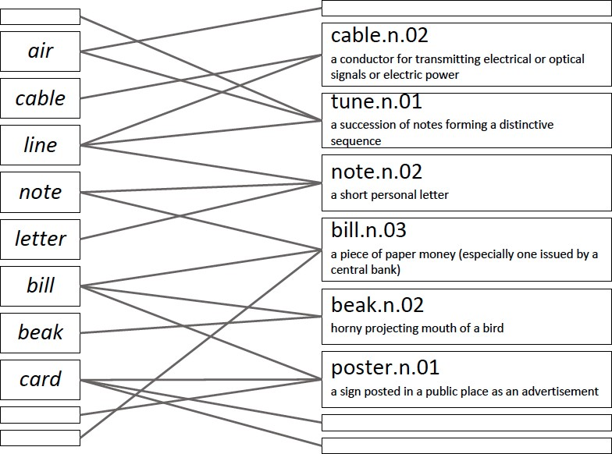
lemma vs. synsets
Lexical Semantics - WordNet
Week 8, Lecture 2

Slide 22
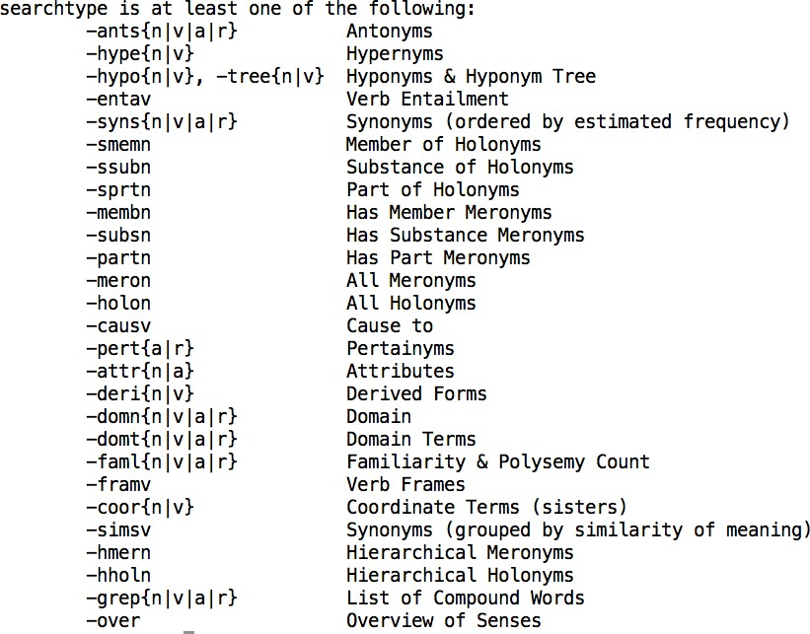
All relations in WordNet
Lexical Semantics - WordNet
Week 8, Lecture 2

Slide 23
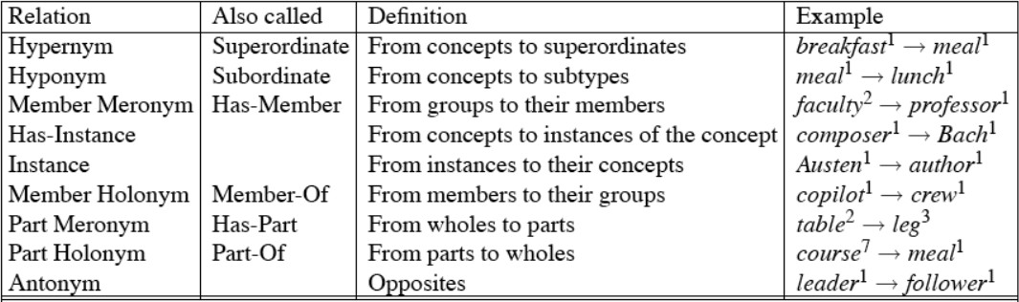
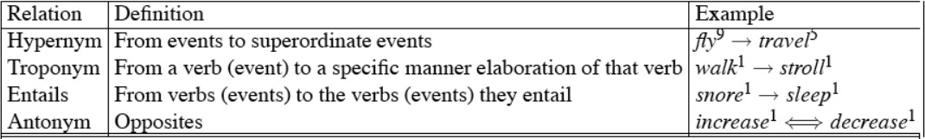
Wordnet noun and verb relations
Lexical Semantics - WordNet
Week 8, Lecture 2

Slide 24
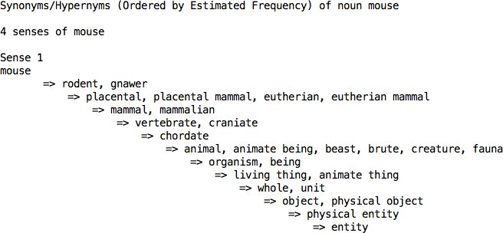
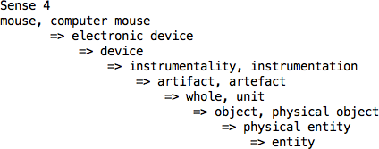
WordNet Hierarchies
Lexical Semantics - WordNet
Week 8, Lecture 2

Slide 25
Word Similarity
Synonymy is a binary relation
Two words are either synonymous or not
We want a looser metric
Word similarity or
Word distance
Two words are more similar
If they share more features of meaning
Actually these are really relations between senses:
Instead of saying “bank is like fund”
We say
^{F} Bank¹ is similar to fund³
^{F} Bank² is similar to slope⁵
We will compute similarity over both words and senses
Lexical Semantics - WordNet
Week 8, Lecture 2

Slide 26
Two classes of algorithms
Distributional algorithms
By comparing words based on their distributional context in the corpora
Thesaurus-based algorithms
Based on whether words are “nearby” in WordNet
Lexical Semantics - WordNet
Week 8, Lecture 2

Slide 27
Thesaurus-based Word Similarity
We could use anything in the thesaurus:
Meronymy, hyponymy, troponymy
Glosses and example sentences
In practice, “thesaurus-based” methods usually use:
the is-a/subsumption/hypernymy hierarchy
and sometimes the glosses too
Word similarity vs. word relatedness
Similar words are near-synonyms
Related words could be related any way
^{F} car, gasoline : related, but nor similar
^{F} car, bicycle: similar
Lexical Semantics - WordNet
Week 8, Lecture 2
10 / 27

Slide 28
Path-based similarity
Basic Idea
Two words are similar if they are nearby in the hypernym graph
pathlen(c₁, c₂) = number of edges in shortest path (in hypernym graph) between senses c₁ and c₂
sim_{path}(c₁, c₂) = ₁
1
+pathlen(c1,c2)
^{sim(w}1^{, w}2^{) = max}c1∈senses(w1),c2∈senses(w2)^{sim(c}1^{, c}2⁾
Lexical Semantics - WordNet
Week 8, Lecture 2
11 / 27

Slide 29
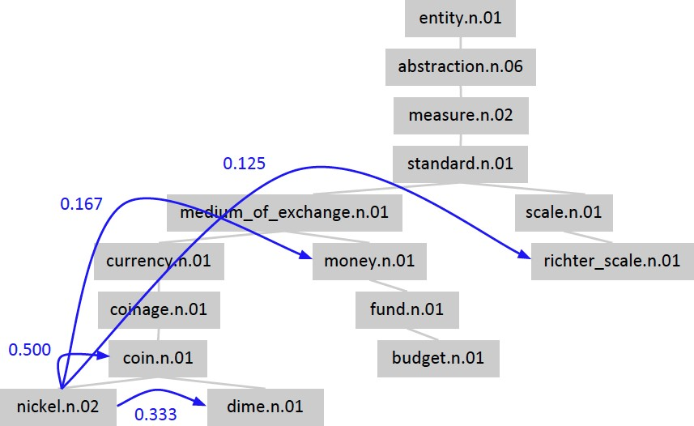
Shortest path in the hierarchy
Lexical Semantics - WordNet
Week 8, Lecture 2
12 / 27

Slide 30
Leacock-Chodorow (L-C) Similarity
L-C similarity
sim_{LC}(c₁, c₂) = −log(pathlen(c₁, c₂)/2d) d: maximum depth of the hierarchy
Problems with L-C similarity
Assumes each edge represents a uniform distance ‘nickel-money’ seems closer than ‘nickel-standard’
We want a metric which lets us assign different “lengths” to different edges - but how?
Lexical Semantics - WordNet
Week 8, Lecture 2
13 / 27

Slide 31
Concept probability models
Cencept probabilities
For each concept (synset) c, let P(c) be the probability that a randomly selected word in a corpus is an instance (hyponym) of c
P(ROOT) = 1
The lower a node in the hierarchy, the lower its probability
Estimating concept probabilities
Train by counting “concept activations” in a corpus
Each occurrence of dime also increments counts for coin, currency, standard, etc.
Lexical Semantics - WordNet
Week 8, Lecture 2
14 / 27

Slide 32
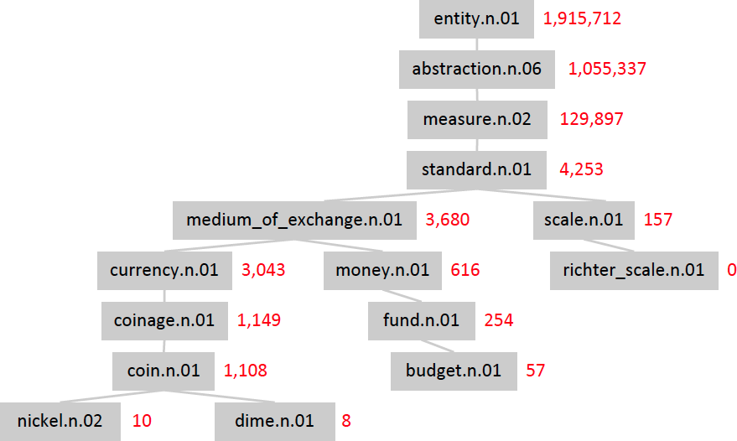
Example : concept count
Lexical Semantics - WordNet
Week 8, Lecture 2
15 / 27

Slide 33
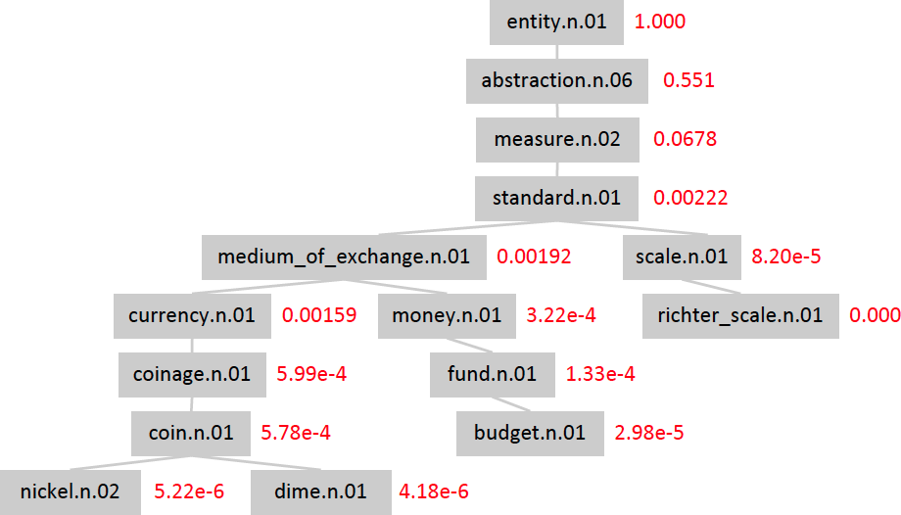
Example : concept probabilities
Lexical Semantics - WordNet
Week 8, Lecture 2
16 / 27

Slide 34
Information content
Information content
Information content: IC(c) = −logP(c)
Lowest common subsumer : LCS(c₁, c₂): the lowest node in the hierarchy that subsumes (is a hypernym of) both c₁ and c₂
We are now ready to see how to use information content (IC) as a similarity metric.
Lexical Semantics - WordNet
Week 8, Lecture 2
17 / 27

Slide 35
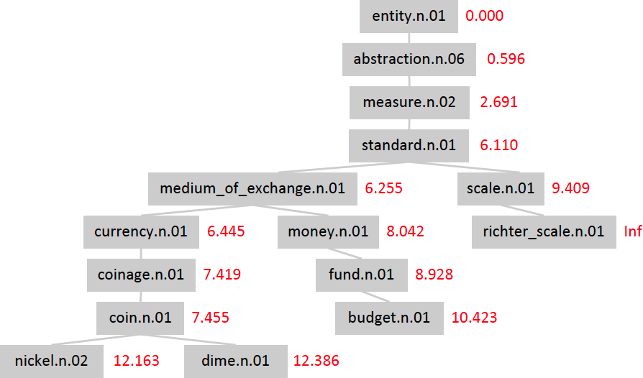
Example : Information content
Lexical Semantics - WordNet
Week 8, Lecture 2
18 / 27

Slide 36
Resnik Similarity
Resnik Similarity
Intuition: how similar two words are depends on how much they have in common
It measures the commonality by the information content of the lowest common subsumer
sim_{resnik}(c₁, c₂) = IC(LCS(c₁, c₂)) = −logP(LCS(c₁, c₂))
Lexical Semantics - WordNet
Week 8, Lecture 2
19 / 27

Slide 37
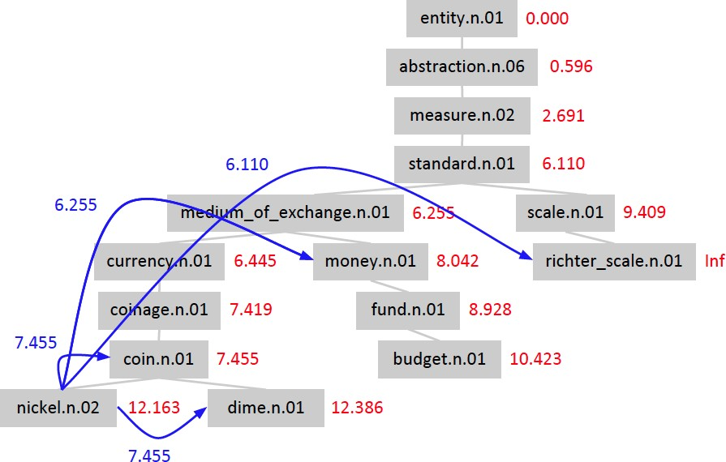
Example: Resnik similarity
Lexical Semantics - WordNet
Week 8, Lecture 2
20 / 27

Slide 38
Lin similarity
Proportion of shared information
It’s not just about commonalities - it’s also about differences!
Resnik: The more information content they share, the more similar they are
Lin: The more information content they don’t share, the less similar they are
Not the absolute quantity of shared information but the proportion of shared information
_{simLin(c1, c2) =} 2logP(LCS(c₁, c₂))
logP(c₁) + logP(c₂)
The information content common to c₁ and c₂, normalized by their average information content.
Lexical Semantics - WordNet
Week 8, Lecture 2
21 / 27

Slide 39

Example: Lin similarity
Lexical Semantics - WordNet
Week 8, Lecture 2
22 / 27

Slide 40
Jiang-Conrath distance
JC similarity
We can use IC to assign lengths to graph edges:
dist_{JC}(c, hypernym(c)) = IC(c) − IC(hypernym(c)) dist_{JC}(c₁, c₂) = dist_{JC}(c₁, LCS(c₁, c₂)) + dist_{JC}(c₂, LCS(c₁, c₂))
= IC(c₁) − IC(LCS(c₁, c₂)) + IC(c₂) − IC(LCS(c₁, c₂))
= IC(c₁) + IC(c₂) − 2 × IC(LCS(c₁, c₂))
sim_{JC}(c₁, c₂) = ¹
IC(c₁) + IC(c₂) − 2 × IC(LCS(c₁, c₂))
Lexical Semantics - WordNet
Week 8, Lecture 2
23 / 27

Slide 41

Example: Jiang-Conrath distance
Lexical Semantics - WordNet
Week 8, Lecture 2
24 / 27

Slide 42
The (extended) Lesk Algorithm
Two concepts are similar if their glosses contain similar words
Drawing paper: paper that is specially prepared for use in drafting
Decal: the art of transferring designs from specially prepared paper to a wood or glass or metal surface
For each n-word phrase that occurs in both glosses, add a score of n²
paper and specially prepared → 1 + 4 = 5
Lexical Semantics - WordNet
Week 8, Lecture 2
25 / 27

Slide 43
Problem in mapping words to wordnet senses
I saw a man who is 98 years old and can still walk and tell jokes
Lexical Semantics - WordNet
Week 8, Lecture 2
26 / 27

Slide 44
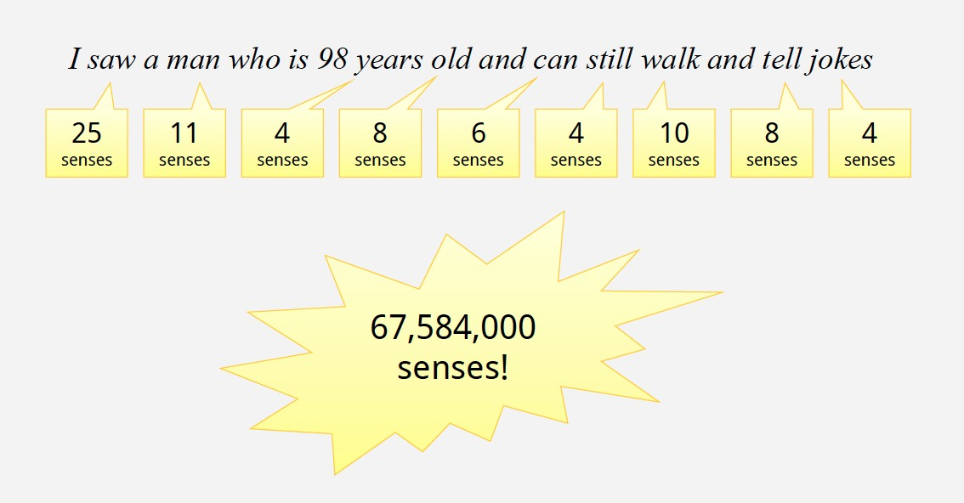
Ambiguity is rampant!
Lexical Semantics - WordNet
Week 8, Lecture 2
27 / 27

Slide 45
Word Sense Disambiguation - I
Pawan Goyal
CSE, IIT Kharagpur
Week 8, Lecture 3
Word Sense Disambiguation - I
Week 8, Lecture 3

Slide 46
Word Sense Disambiguation (WSD)
Sense ambiguity
Many words have several meanings or senses
The meaning of bass depends on the context Are we talking about music, or fish?
An electric guitar and bass player stand off to one side, not really part of the scene, just as a sort of nod to gringo expectations perhaps.
And it all started when fishermen decided the striped bass in Lake Mead were too skinny.
Disambiguation
The task of disambiguation is to determine which of the senses of an ambiguous word is invoked in a particular use of the word.
This is done by looking at the context of the word’s use.
Word Sense Disambiguation - I
Week 8, Lecture 3
2 / 15

Slide 47
Algorithms
Knowledge Based Approaches
Overlap Based Approaches
Machine Learning Based Approaches
Supervised Approaches
Semi-supervised Algorithms
Unsupervised Algorithms
Hybrid Approaches
Word Sense Disambiguation - I
Week 8, Lecture 3

Slide 48
Knowledge Based Approaches
Overlap Based Approaches
Require a Machine Readable Dictionary (MRD).
Find the overlap between the features of different senses of an ambiguous word (sense bag) and the features of the words in its context (context bag).
The features could be sense definitions, example sentences, hypernyms etc.
The features could also be given weights.
The sense which has the maximum overlap is selected as the contextually appropriate sense.
Word Sense Disambiguation - I
Week 8, Lecture 3

Slide 49
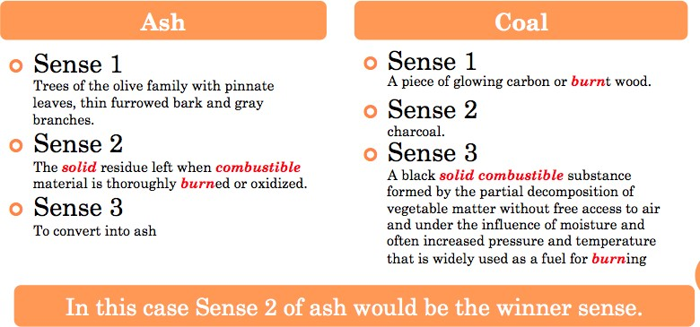
Lesk’s Algorithm
Sense Bag: contains the words in the definition of a candidate sense of the ambiguous word.
Context Bag: contains the words in the definition of each sense of each context word.
On burning coal we get ash.
Word Sense Disambiguation - I
Week 8, Lecture 3
5 / 15

Slide 50
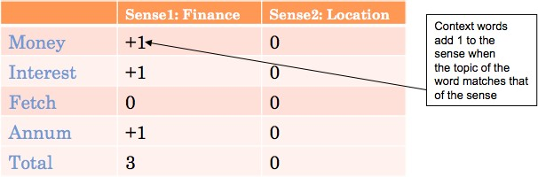
Walker’s Algorithm
A Thesaurus Based approach
Step 1: For each sense of the target word find the thesaurus category to which that sense belongs
Step 2: Calculate the score for each sense by using the context words. A context word will add 1 to the score of the sense if the thesaurus category of the word matches that of the sense.
E.g. The money in this bank fetches an interest of 8% per annum
Target word: bank
Clue words from the context: money, interest, annum, fetch
Word Sense Disambiguation - I
Week 8, Lecture 3
6 / 15

Slide 51
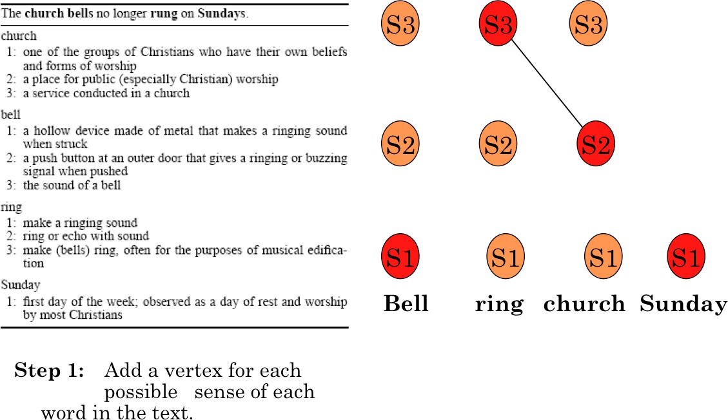
WSD Using Random Walk Algorithm
Word Sense Disambiguation - I
Week 8, Lecture 3
7 / 15

Slide 52
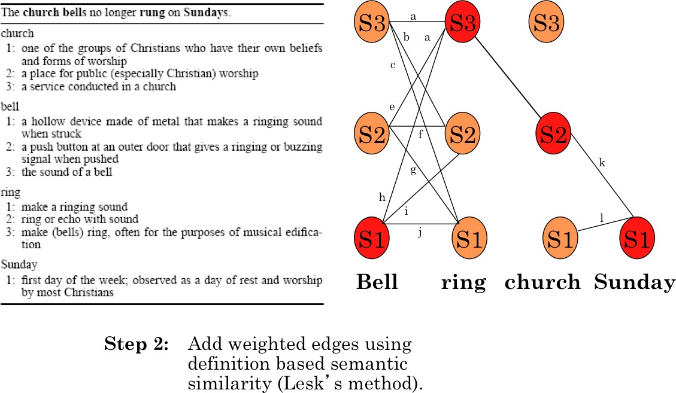
WSD Using Random Walk Algorithm
Word Sense Disambiguation - I
Week 8, Lecture 3
8 / 15

Slide 53
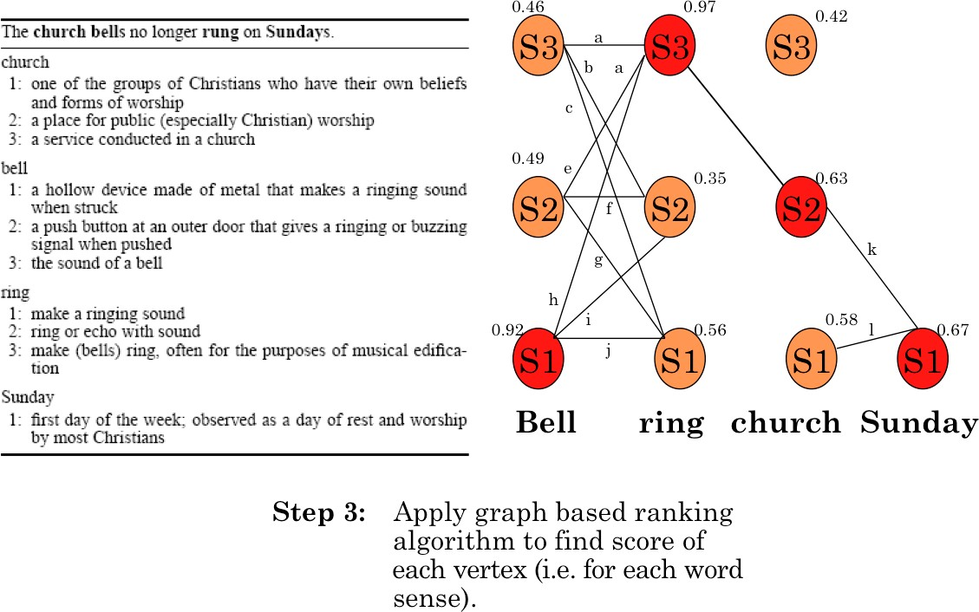
WSD Using Random Walk Algorithm
Word Sense Disambiguation - I
Week 8, Lecture 3
9 / 15

Slide 54
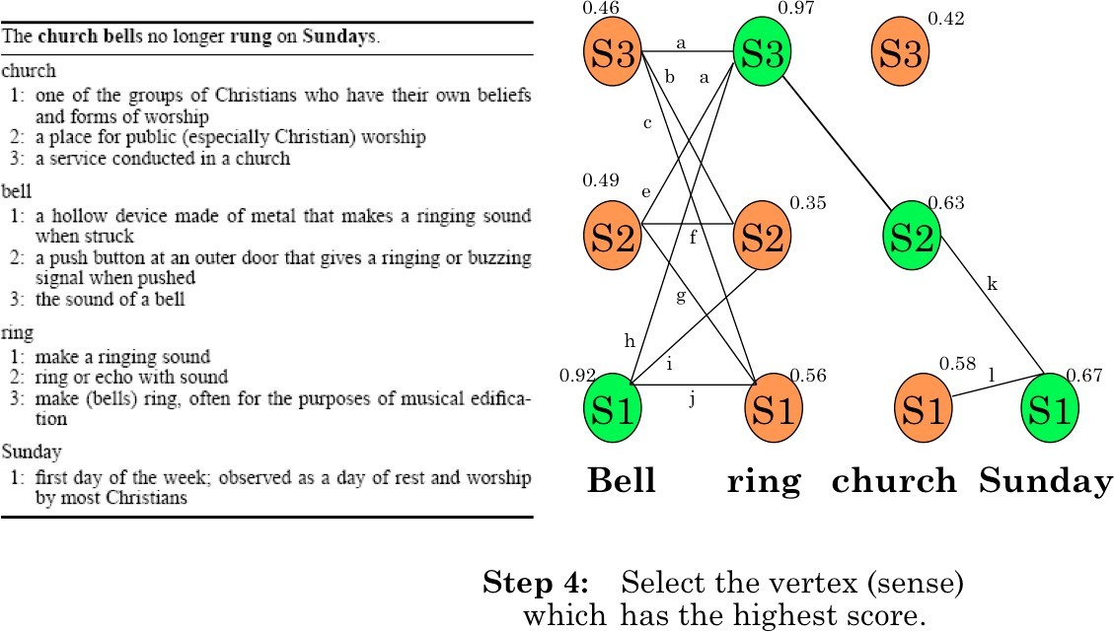
WSD Using Random Walk Algorithm
Word Sense Disambiguation - I
Week 8, Lecture 3
10 / 15

Slide 55
Naïve Bayes for WSD
A Naïve Bayes classifier chooses the most likely sense for a word given the features of the context:
ˆs = argmax P(s|f )
s∈S
Using Bayes’ law, this can be expressed as:
_{ˆs = argmax} P(s)P(f |s)
s∈S
P(f )
= argmax P(s)P(f |s)
s∈S
The ‘Naïve’ assumption: all the features are conditionally independent, given the sense’:
n
.
ˆs = argmax P(s) P(f |s)
j
s∈S
j=1
Word Sense Disambiguation - I
Week 8, Lecture 3
11 / 15

Slide 56
Training for Naïve Bayes
‘f ’ is a feature vector consisting of:
POS of w
Semantic and Syntactic features of w
Collocation vector (set of words around it) → next word (+1), +2, -1, -2 and their POS’s
Co-occurrence vector
Set parameters of Naïve Bayes using maximum likelihood estimation (MLE) from training data
count(s_{i}, w_{j})
P(s ) =
i
count(w_{j})
count(f_{j}, s_{i})
P(f |s ) =
j i
count(s_{i})
Word Sense Disambiguation - I
Week 8, Lecture 3
12 / 15

Slide 57
Decision List Algorithm
Based on ‘One sense per collocation’ property
Nearby words provide strong and consistent clues as to the sense of a target word
Collect a large set of collocations for the ambiguous word
Calculate word-sense probability distributions for all such collocations Calculate the log-likelihood ratio
_{log(} P(Sense − A|Collocation_{i})₎ P(Sense − B|Collocation_{i})
Higher log-likelihood ⇒ more predictive evidence
Collocations are ordered in a decision list, with most predictive collocations ranked highest
Word Sense Disambiguation - I
Week 8, Lecture 3
13 / 15

Slide 58
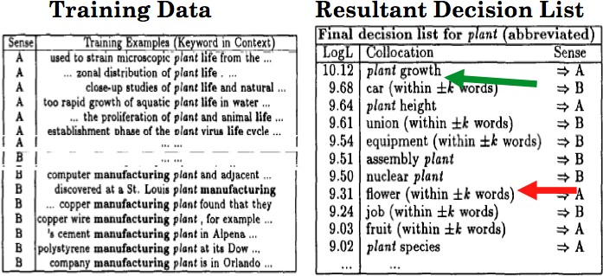
Decision List Algorithm
Classification of a test sentence is based on the highest ranking collocation, found in the test sentences.
plucking flowers affects plant growth.
Word Sense Disambiguation - I
Week 8, Lecture 3
14 / 15

Slide 59
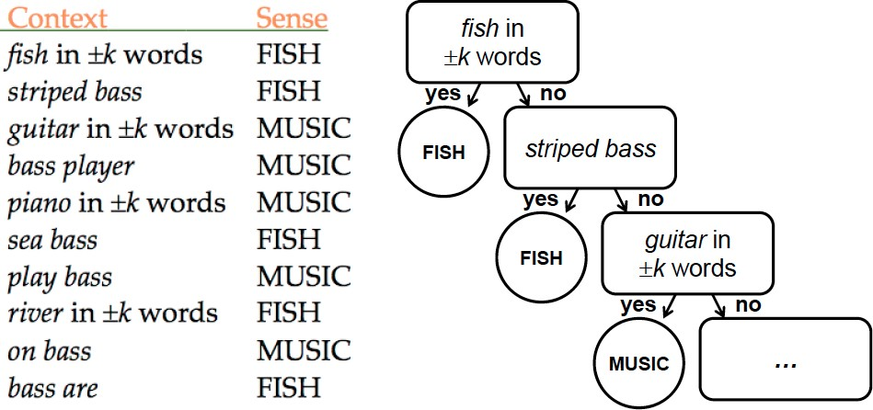
Example: discriminating between bass (fish) and bass (music):
Decision List: Example
Word Sense Disambiguation - I
Week 8, Lecture 3
15 / 15

Slide 60
Word Sense Disambiguation - II
Pawan Goyal
CSE, IIT Kharagpur
Week 8, Lecture 4
Word Sense Disambiguation - II
Week 8, Lecture 4

Slide 61
Minimally Supervised WSD - Yarowsky
Annotations are expensive! “Bootstrapping” or co-training
Start with (small) seed, learn decision list
Use decision list to label rest of corpus
Retain ‘confident’ labels, treat as annotated data to learn new decision list
Repeat . . .
Heuristics (derived from observation):
One sense per discourse
One sense per collocation
Word Sense Disambiguation - II
Week 8, Lecture 4
2 / 14

Slide 62
More about heuristics
One Sense per Discourse
A word tends to preserve its meaning across all its occurrences in a given discourse
One Sense per Collocation
A word tends to preserve its meaning when used in the same collocation
Strong for adjacent collocations
Weaker as the distance between the words increases
Word Sense Disambiguation - II
Week 8, Lecture 4
3 / 14

Slide 63
Yarowsky’s Method
Example
Disambiguating plant (industrial sense) vs. plant (living thing sense) Think of seed features for each sense
Industrial sense: co-occurring with ‘manufacturing’
Living thing sense: co-occurring with ‘life’
Use ‘one sense per collocation’ to build initial decision list classifier
Treat results (having high probability) as annotated data, train new decision list classifier, iterate
Word Sense Disambiguation - II
Week 8, Lecture 4

Slide 64
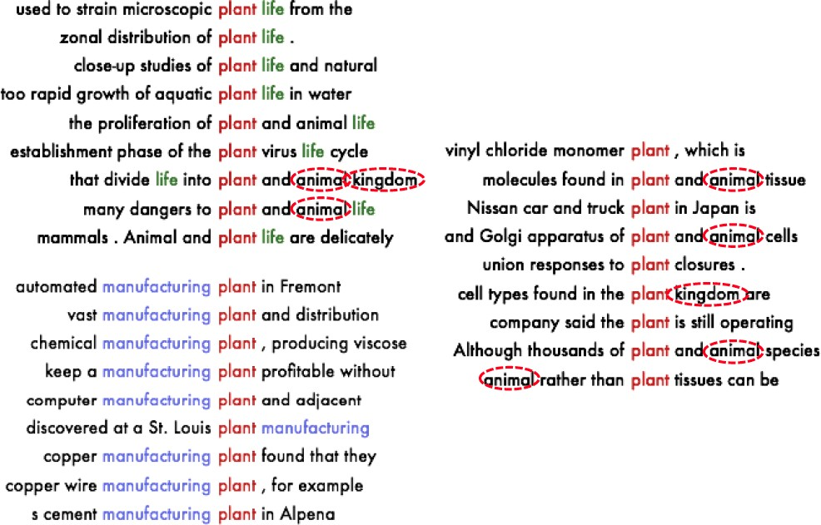
Yarowsky’s Method: Example
Word Sense Disambiguation - II
Week 8, Lecture 4

Slide 65
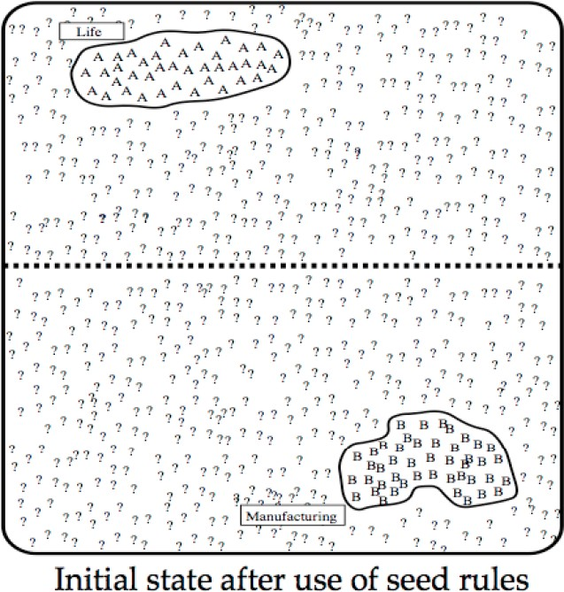
Yarowsky’s Method: Example
Word Sense Disambiguation - II
Week 8, Lecture 4

Slide 66
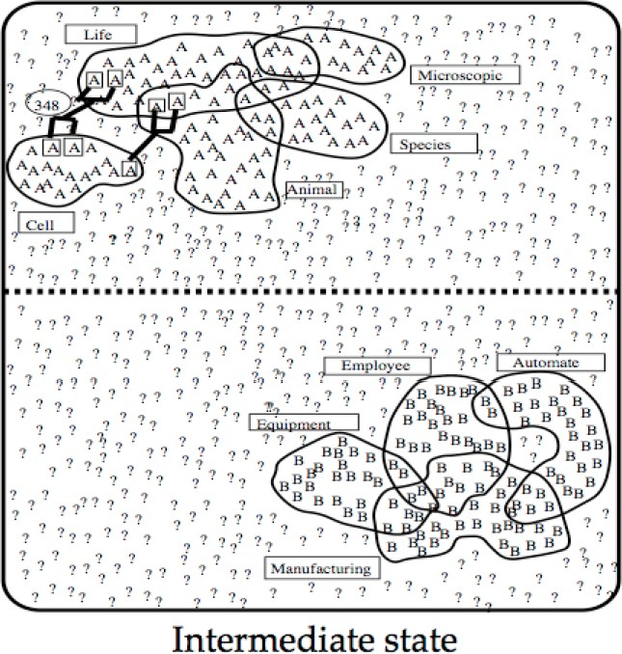
Yarowsky’s Method: Example
Word Sense Disambiguation - II
Week 8, Lecture 4

Slide 67
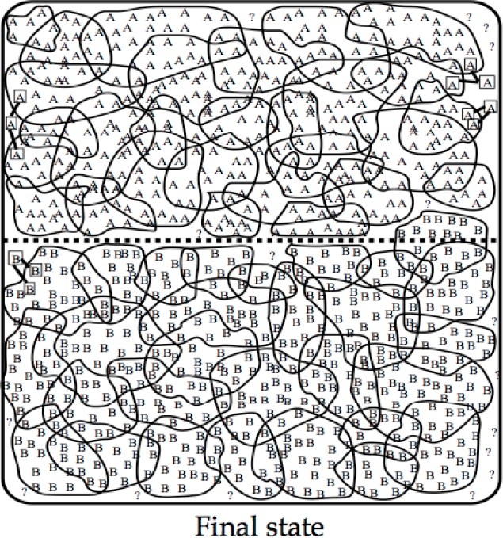
Yarowsky’s Method: Example
Word Sense Disambiguation - II
Week 8, Lecture 4

Slide 68
Yarowsky’s Method
Termination
Stop when
Error on training data is less than a threshold
No more training data is covered
Use final decision list for WSD
Advantages
Accuracy is about as good as a supervised algorithm Bootstrapping: far less manual effort
Word Sense Disambiguation - II
Week 8, Lecture 4

Slide 69
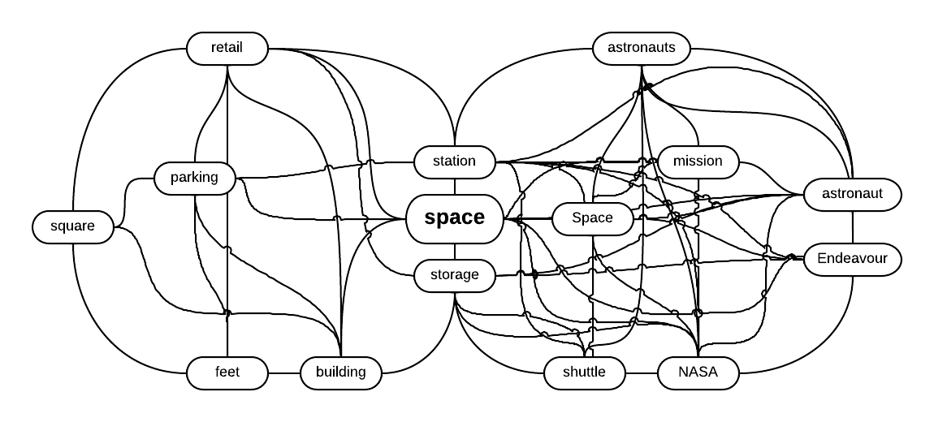
HyperLex
Key Idea: Word Sense Induction
Instead of using “dictionary defined senses”, extract the “senses from the corpus” itself
These “corpus senses” or “uses” correspond to clusters of similar contexts for a word.
Word Sense Disambiguation - II
Week 8, Lecture 4
10 / 14

Slide 70
HyperLex
Detecting Root Hubs
Different uses of a target word form highly interconnected bundles (or high density components)
In each high density component one of the nodes (hub) has a higher degree than the others.
Step 1: Construct co-occurrence graph, G.
Step 2: Arrange nodes in G in decreasing order of degree.
Step 3: Select the node from G which has the highest degree. This node will be the hub of the first high density component.
Step 4: Delete this hub and all its neighbors from G.
Step 5: Repeat Step 3 and 4 to detect the hubs of other high density components
Word Sense Disambiguation - II
Week 8, Lecture 4
11 / 14

Slide 71
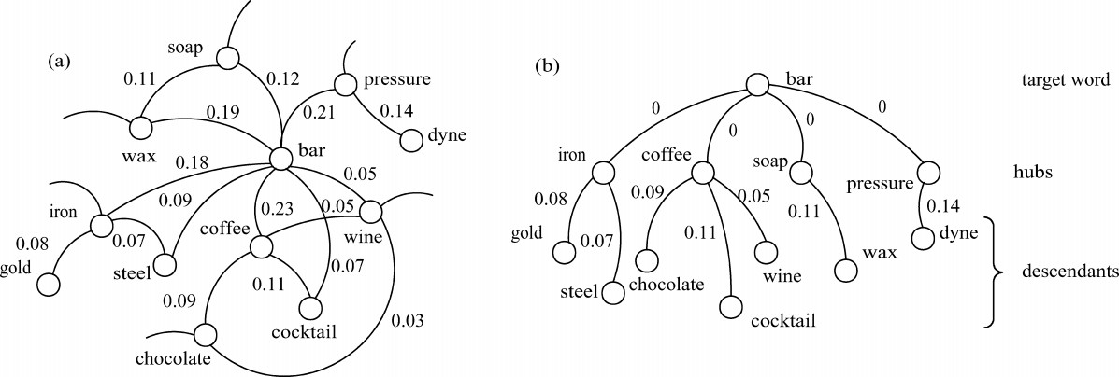
HyperLex: Detecting Root Hubs
Word Sense Disambiguation - II
Week 8, Lecture 4
12 / 14

Slide 72
Delineating Components
Attach each node to the root hub closest to it.
The distance between two nodes is measured as the smallest sum of weights of the edges on the paths linking them.
Computing distance between two nodes w_{i} and w_{j}
w_{ij} = 1 − max{P(w_{i}|w_{j}), P(w_{j}|w_{i})}
where P
(w |w ) =
freq
ij
i j
freqj
Word Sense Disambiguation - II
Week 8, Lecture 4
13 / 14

Slide 73
Disambiguation
Let W = (w₁, w₂,..., w_{i}, . . . , w_{n}) be a context in which w_{i} is an instance of our target word.
Let w_{i} has k hubs in its minimum spanning tree
A score vector s is associated with each w_{j} ∈ W(j ≠ i), such that s_{k} represents the contribution of the kth hub as:
s_{k} = ¹ if h_{k} is an ancestor of w_{j}
s_{i}
1 + d(h_{k}, w_{j})
= 0 otherwise.
All score vectors associated with all w_{j} ∈ W(j ≠ i) are summed up The hub which receives the maximum score is chosen as the most appropriate sense
Word Sense Disambiguation - II
Week 8, Lecture 4
14 / 14

Slide 74
Novel Word Sense Detection
Pawan Goyal
CSE, IIT Kharagpur
Week 8, Lecture 5
Novel Word Sense Detection
Week 8, Lecture 5
1 / 5

Slide 75
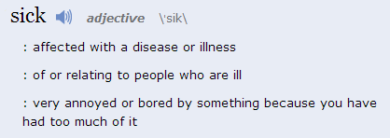
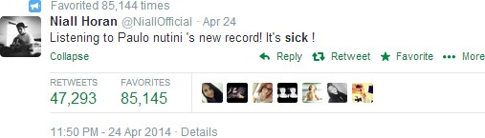
Tracking Sense Changes
Classical sense
1
Novel sense
¹http://www.merriam-webster.com/
Novel Word Sense Detection
Week 8, Lecture 5
2 / 5

Slide 76
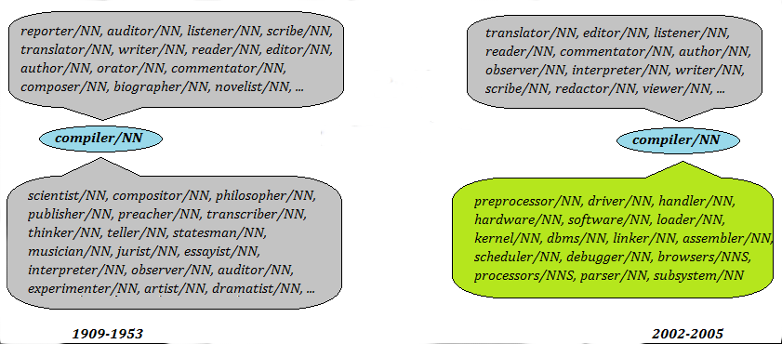
Comparing sense clusters
If a word undergoes sense change, this can be detected by comparing the sense clusters obtained from two different time periods
Novel Word Sense Detection
Week 8, Lecture 5
3 / 5

Slide 77
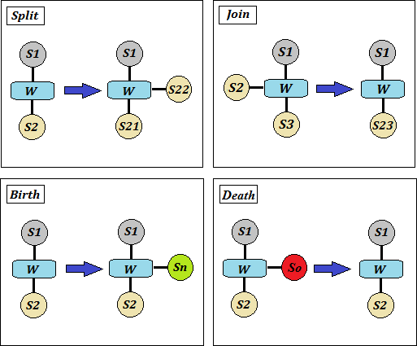
Split, join, birth and death
Novel Word Sense Detection
Week 8, Lecture 5
4 / 5

Slide 78
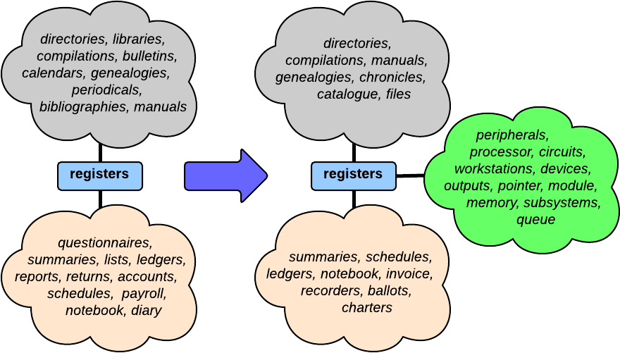
A real example of birth
Novel Word Sense Detection
Week 8, Lecture 5
5 / 5

